Slide 1
Data Structures Basics
AI2C Tech Intro

Slide 2
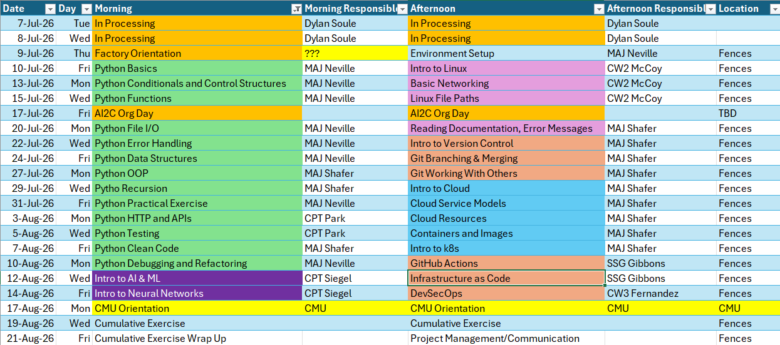
Course Schedule

Slide 3
Review

Slide 4
What did we do last lesson?

Slide 5
Pre class problem 1
Intelligence analysts have intercepted a transmission from an enemy outpost. The signal contains 100 scrambled numeric values — but buried inside are the true coordinates of the enemy's hidden command center.
Your commanding officer explains: "The enemy encodes their location by hiding it in plain sight. Take the 5 highest signal values, sum them together, then divide by 10. The result is the target's grid coordinate."
Your mission: write a Python program to decode the transmission and report the coordinates. You have 20 minutes to finish this before the enemy moves their command post.
Notes:
✅ The answer students should get: Grid coordinate 47.3 (Top 5 values: 98, 96, 95, 92, 92 → sum = 473 → ÷ 10 = 47.3)

Slide 6
Objectives
Understand the difference between lists, tuples, dictionaries, and sets.
Know when and how to apply nested lists
Implement and discuss some basic list manipulation techniques

Slide 7
Lists
Feature | Detail
Syntax | my_list = [1, 2, 3]
Ordered | ✅ Yes — items maintain insertion order
Mutable | ✅ Yes — items can be added, removed, or changed
Duplicates allowed | ✅ Yes
Indexable | ✅ Yes — zero-based: my_list[0] returns 1
Can mix data types | ✅ Yes — [1, "hello", 3.14, True] is valid
Nestable | ✅ Yes — lists can contain other lists
Common methods | .append(), .remove(), .sort(), .pop(), .reverse(), .extend()
Common use case | Any ordered, changeable collection of items

Slide 8
TUPLES
Feature | Detail
Syntax | my_tuple = (1, 2, 3)
Ordered | ✅ Yes — items maintain insertion order
Mutable | ❌ No — once created, items cannot be changed
Duplicates allowed | ✅ Yes
Indexable | ✅ Yes — zero-based: my_tuple[0] returns 1
Can mix data types | ✅ Yes — (1, "hello", 3.14, True) is valid
Nestable | ✅ Yes — tuples can contain other tuples
Common methods | .count(), .index() (only 2 — immutability limits options)
Common use case | Fixed data that shouldn't change: coordinates, RGB values, database records
Unpacking | ✅ Yes — x, y, z = (1, 2, 3) assigns each value to a variable
Single-item syntax | Requires trailing comma — (5,) is a tuple; (5) is just an integer

Slide 9
MUTABLE VS IMMUTABLE
Mutable means you can change an object after it's created. Immutable means you cannot.
# List (mutable) — you CAN change it
my_list = [1, 2, 3]
my_list[0] = 99
print(my_list) # [99, 2, 3] ✅
# Tuple (immutable) — you CANNOT change it
my_tuple = (1, 2, 3)
my_tuple[0] = 99 # ❌ TypeError: 'tuple' object does not support item assignment

Slide 10
Initializing Lists
# Empty list
my_list = []
my_list = list()
# With values
my_list = [1, 2, 3]
# From another iterable
my_list = list("hello") # ['h', 'e', 'l', 'l', 'o']
my_list = list((1, 2, 3)) # [1, 2, 3] (from a tuple)
my_list = list(range(5)) # [0, 1, 2, 3, 4]
# List comprehension
my_list = [x * 2 for x in range(5)] # [0, 2, 4, 6, 8]
# Repeated values
my_list = [0] * 5 # [0, 0, 0, 0, 0]

Slide 11
Initializing TUPLES
# Empty tuple
my_tuple = ()
my_tuple = tuple()
# With values
my_tuple = (1, 2, 3)
# Parentheses are actually optional
my_tuple = 1, 2, 3 # (1, 2, 3)
# Single item (trailing comma is required!)
my_tuple = (5,) # (5,) ✅
my_tuple = (5) # 5 ❌ this is just an integer
# From another iterable
my_tuple = tuple("hello") # ('h', 'e', 'l', 'l', 'o')
my_tuple = tuple([1, 2, 3]) # (1, 2, 3) (from a list)
my_tuple = tuple(range(5)) # (0, 1, 2, 3, 4)

Slide 12
A NOTE ABOUT LISTS
my_list = [1, 2, 3]
second_list = my_list
second_list[0] = 100
print(my_list)

Slide 13
Copying Lists
my_list = [1, 2, 3]
# Slice copy
copy = my_list[:]
# .copy() method
copy = my_list.copy()
# list() constructor
copy = list(my_list)
# Deep copy (use when list contains nested lists)
import copy
copy = copy.deepcopy(my_list)

Slide 14
Copying TUPLES
my_tuple = (1, 2, 3)
# Since tuples are immutable, you rarely need to copy them
# Simply assign — both variables safely point to the same object
copy = my_tuple
# tuple() constructor (creates a new object)
copy = tuple(my_tuple)
# Deep copy (use when tuple contains nested mutable objects)
import copy
copy = copy.deepcopy(my_tuple)

Slide 15
Hands-On #1 – Basic algos
Mutable and immutable structures
Working with tuples and lists

Slide 16
Add stuff about dictionaries

Slide 17
Hands-On #2
Work with nested lists to represent arrays

Slide 18
Questions?

